Slide 3
AJK Note: there is a Reusable Tag Library Validator (TLV) library also. It is used for XML validation.

Slide 4
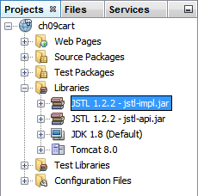

Slide 6
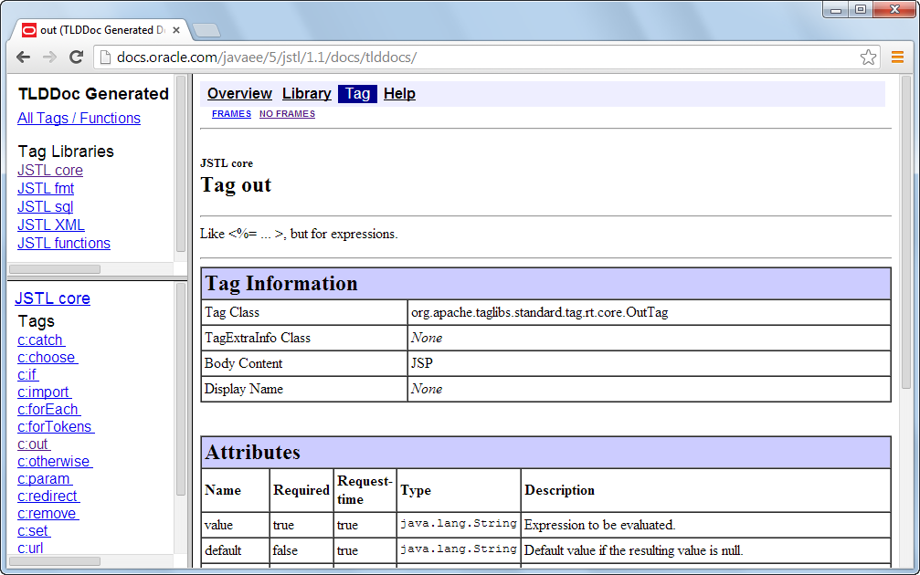
Wikipedia link: https://en.wikipedia.org/wiki/JavaServer_Pages_Standard_Tag_Library

Slide 8
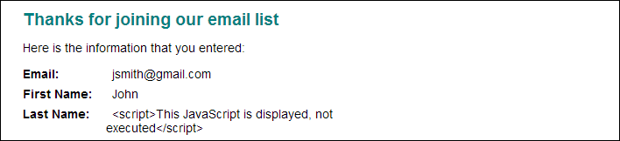

Slide 11
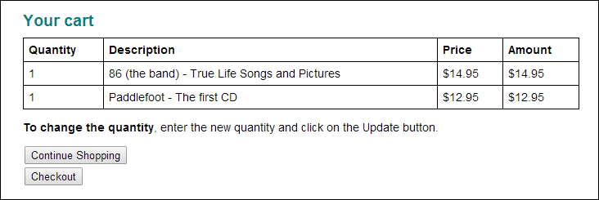

Slide 12
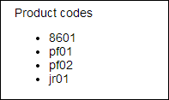

Slide 13


Slide 16
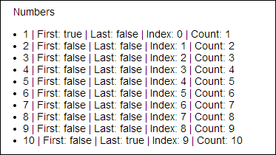

Slide 17
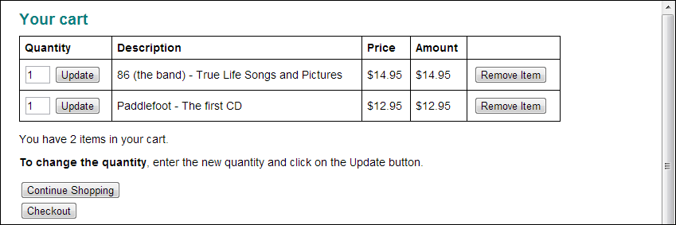

Slide 21
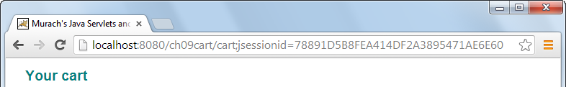

Slide 26
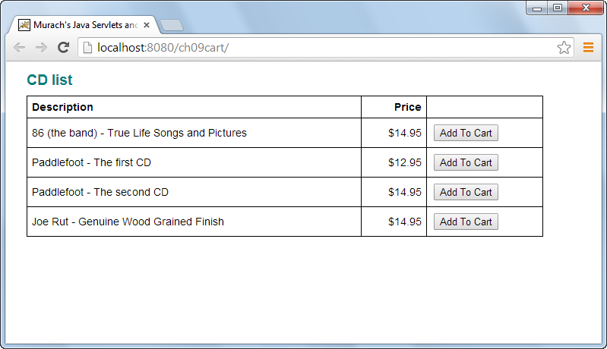

Slide 27
